Slide 1
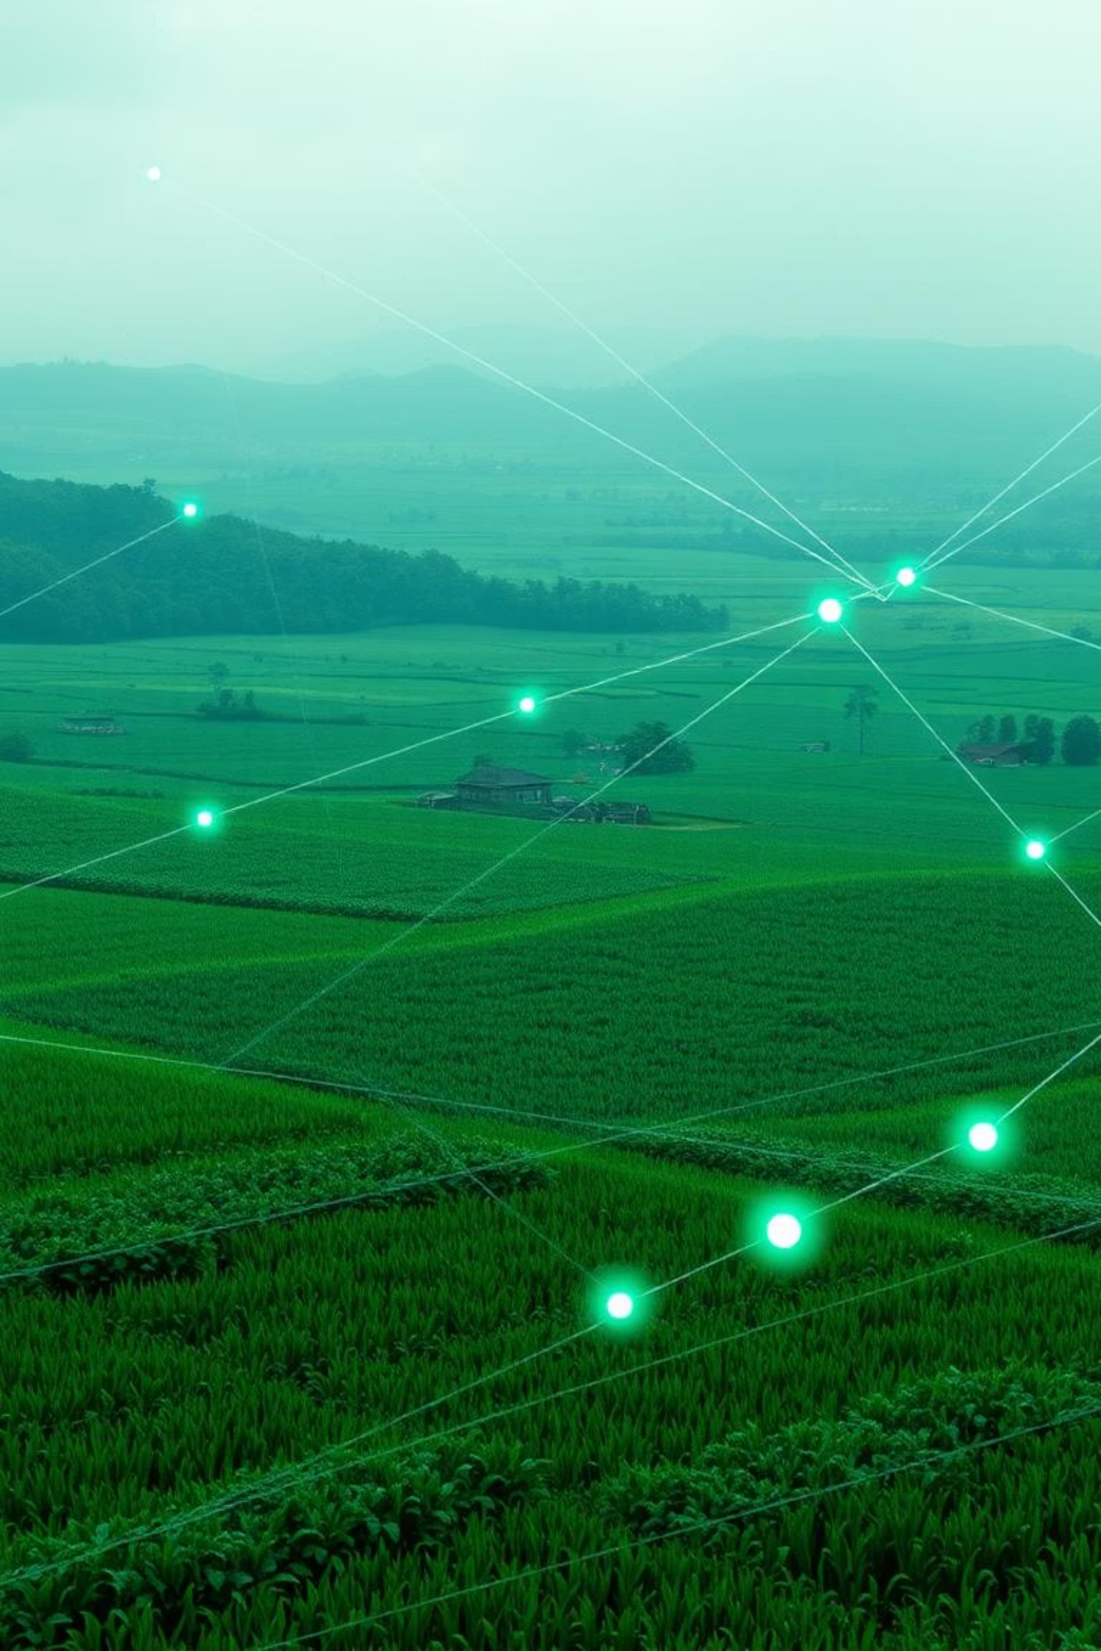
SmartFarm Connect: Cultivating the Future of West African Agriculture
Your Partner in Sustainable Agricultural Growth and Digital Transformation

Slide 2

The Challenge: Bridging the Digital Divide in West African Agriculture
Smallholder farmers across West Africa, the backbone of the region's food security, face formidable challenges that limit their potential and perpetuate cycles of poverty.
Limited Access to Critical Information: Lack of reliable weather forecasts, current market prices, and modern agricultural practices.
Inefficient Practices: Reliance on traditional methods leads to suboptimal yields and high post-harvest losses.
Market Disconnect: Difficulty connecting directly with buyers, leading to exploitation by middlemen and lost revenue.
Exclusion from Modern Tools: Digital divide prevents adoption of technologies that could significantly improve productivity and profitability.

Slide 3




SmartFarm Connect: Our Comprehensive Solution
SmartFarm Connect is an innovative digital platform designed to empower smallholder farmers in West Africa by providing them with essential tools and information directly on their smartphones, even offline.
Real-time Weather & Climate Alerts
Direct Market Access
Hyper-localized forecasts for optimized planting and harvesting decisions.
Connect farmers directly with buyers, ensuring fair prices and reduced intermediaries.
AI-Powered Agronomic Advice
Voice & Multi-language Interface
Personalized recommendations for crop management, pest control, and soil health.
Accessible to all, regardless of literacy levels, supporting local languages and dialects.

Slide 4
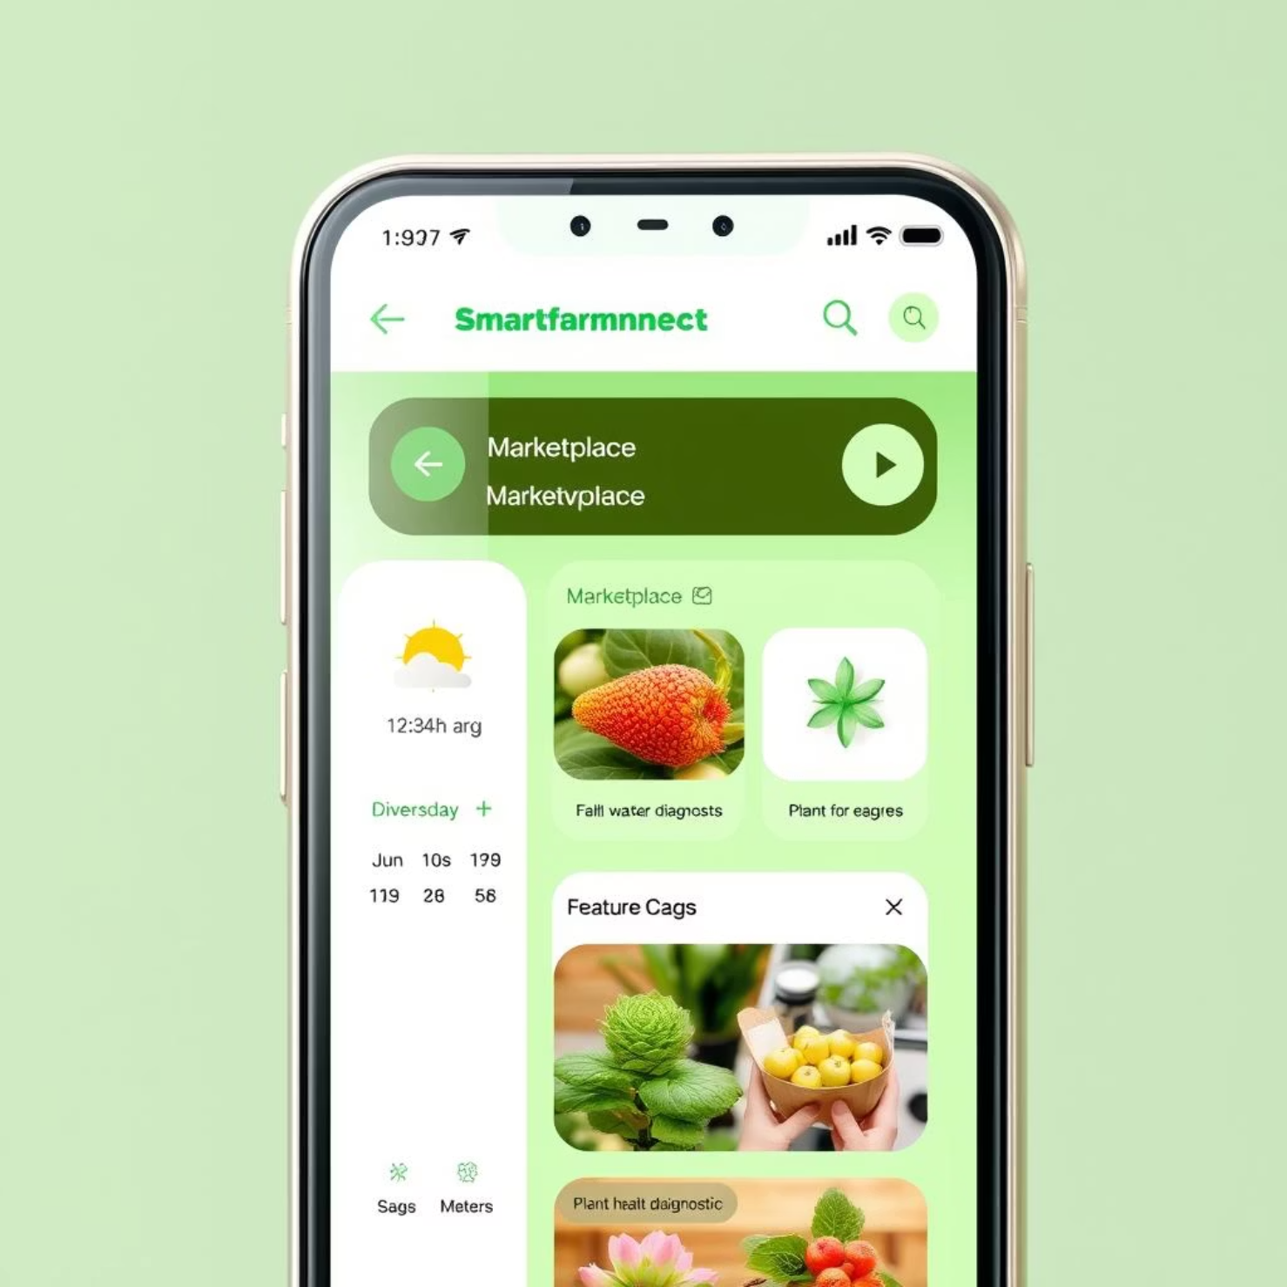
Product Deep Dive: Key Features
Precision Weather Alerts: Integrates data from local IoT weather stations for highly accurate, micro-climatic forecasts.
AI-Driven Crop Diagnostics: Farmers can upload photos of diseased crops for instant identification and recommended solutions.
Dynamic Marketplace: Farmers list produce, buyers submit offers. Transparent pricing and direct negotiation.
Agricultural Best Practices Library: A rich repository of tailored advice on irrigation, fertilization, and sustainable farming techniques.
Offline Functionality: Critical information remains accessible even without internet connectivity, syncing when online.
Voice Commands & Local Languages: Ensures inclusivity and usability for all farmers, regardless of literacy.

Slide 5



Our Target Market: Reaching the Grassroots
Our strategy focuses on reaching key stakeholders who can drive widespread adoption and impact.
Smallholder Farmers
NGOs & Cooperatives
Local & Regional Buyers
Millions across Togo, Benin, and Ghana, seeking to improve yields and livelihoods.
Partnerships to facilitate outreach, training, and collective bargaining.
Connecting directly with farmers for consistent, quality supply chains.

Slide 6
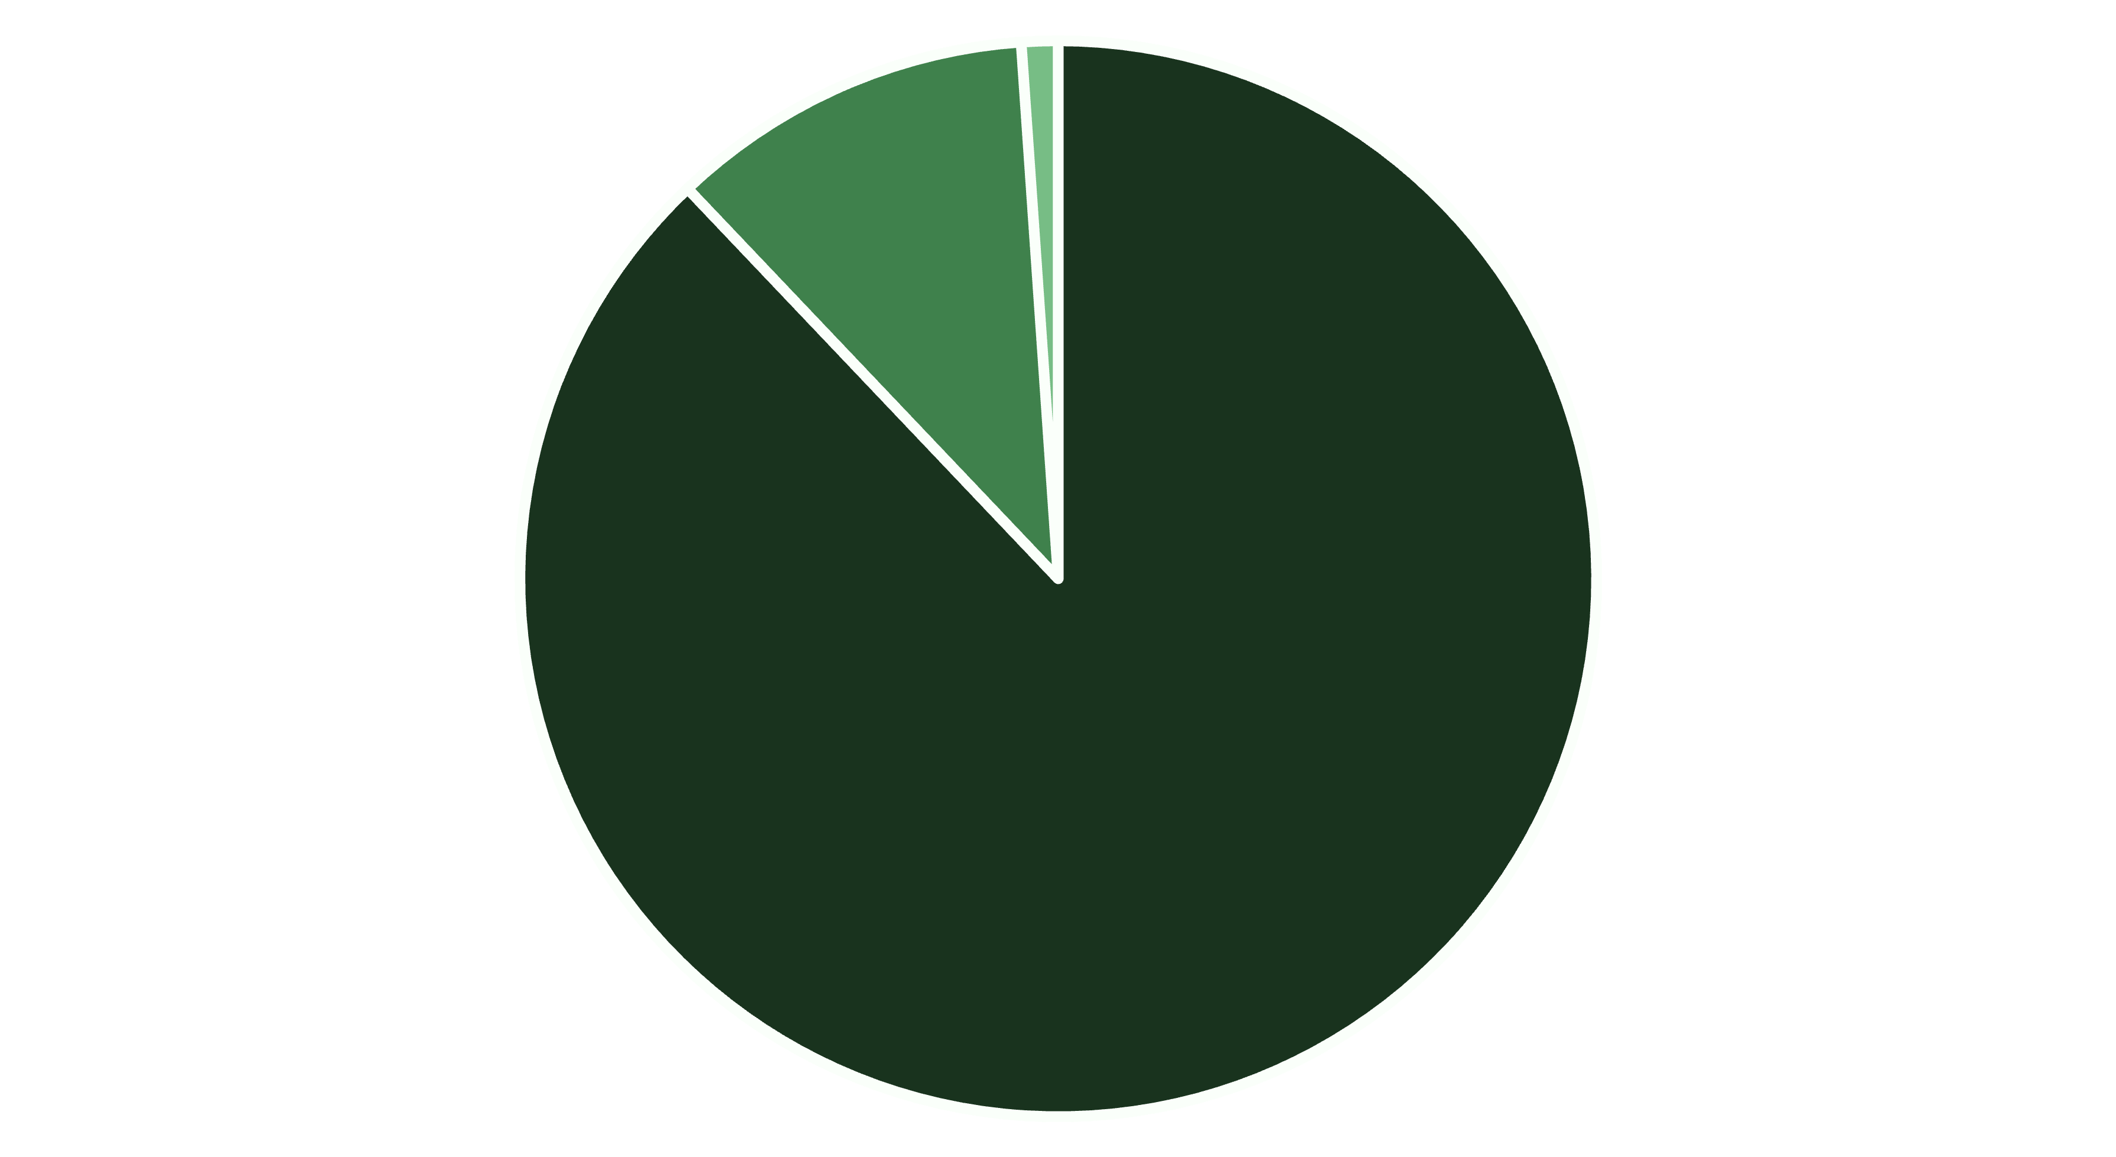
Market Opportunity: TAM, SAM, SOM
The potential for SmartFarm Connect is immense, addressing a vast underserved market.
Total Addressable Market (TAM)
Serviceable Available Marke...
Serviceable Obtainable Mark...
Our initial focus on Togo, Benin, and Ghana represents a strategic entry point into a region ripe for agricultural digital transformation, targeting 5 million users within 3 years.

Slide 7
Competitive Landscape & Our Edge
While existing solutions offer some features, SmartFarm Connect provides a superior, more holistic approach tailored to local needs.
Competitor
Strengths
Limitations
AgroInfo App
Basic market info
No AI, limited weather, not offline, poor UI
M-Farm
SMS-based, group buying
No AI, no voice, limited data depth, only Kenya
FarmDrive
Financial services for farmers
Not focused on agronomy/market access, complex for smallholders

Slide 8
Our Unrivaled Competitive Advantage
AI-Powered Precision
Voice & Local Language Support
Advanced algorithms for personalized, hyper-local advice and crop diagnostics.
Removes literacy barriers, ensuring universal accessibility and ease of use.
Offline Functionality
Hyper-Localized Content
Empowers farmers in remote areas with continuous access to critical information.
Tailored advice and market insights specific to regional crops and practices.

Slide 9
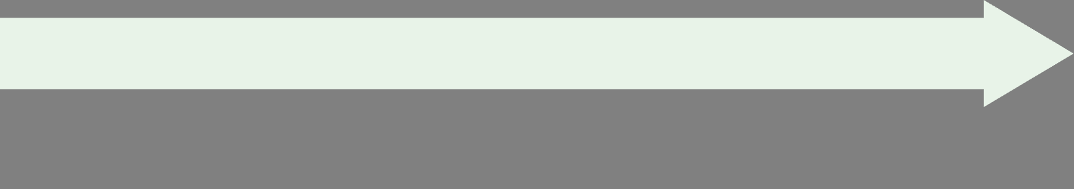
Traction & Roadmap: Our Path to Scale
We've already demonstrated significant success and have a clear plan for aggressive growth.
Partnerships with Cooperatives (Q1 2024)
MVP Launched in Togo (Q4 2023)
Engaged 5 major agricultural cooperatives, expanding reach and training initiatives.
Successfully onboarded 1,200 active smallholder farmers within three months.
Feature Enhancement (Ongoing)
Market Expansion (Q3 2024)
Continuous development of new AI models, improved market algorithms, and IoT integrations.
Planned launch in Benin and Ghana, leveraging successful Togo model and local partnerships.

Slide 10

Investment Opportunity: Funding for Growth
We are seeking 25,000,000 FCFA to accelerate our growth and impact.
Our Revenue Model:
Freemium: Core features accessible to all farmers for free.
Premium Subscription: 1,000 FCFA/month for advanced features and premium content.
Product Development
Marketing & Outreach
Weather Station Infrastructure
Marketplace Commission: 2% commission on successful transactions between farmers and buyers.
Operational Management
B2B Partnerships: Tailored solutions and data insights for NGOs, government agencies, and agricultural businesses.

